Slide 1

Florida SART Concept of Operations
LeiAnna Moorhead
May 29, 2025

Slide 2
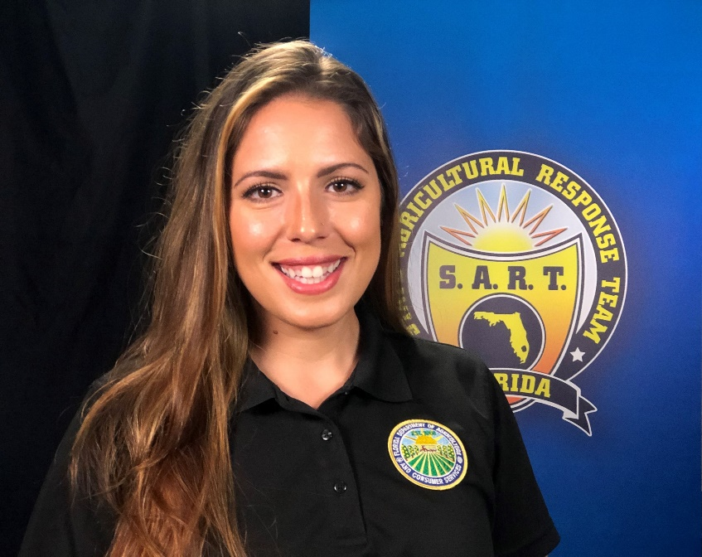
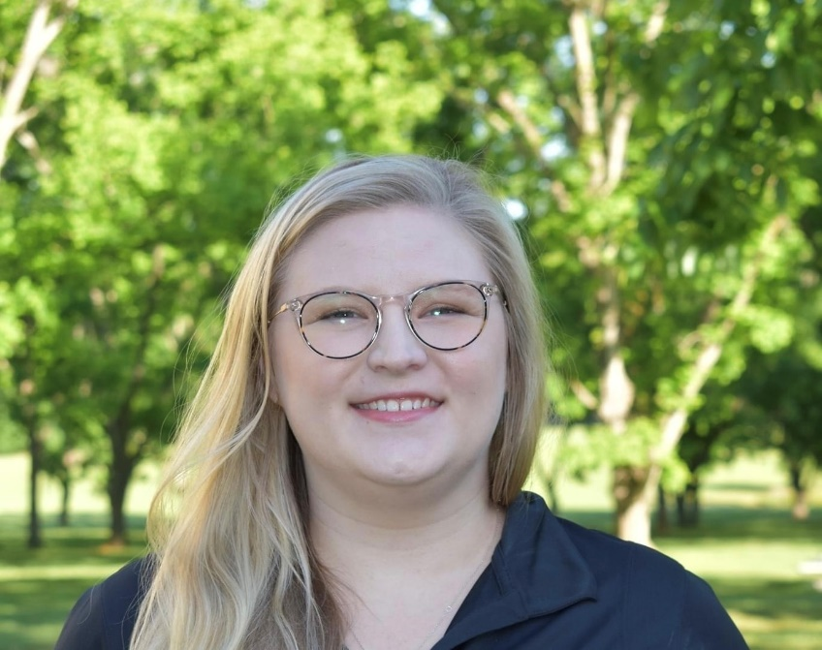

State ESF 17 Emergency Coordinators
LeiAnna Moorhead
Emergency Coordination Officer (ECO)
Emily Nolen
Emergency Coordinator
Josh Wells
Emergency Coordinator
LeiAnna Tucker
Emergency Programs Manager
Emergency Coordinating Officer

Slide 3
Florida Response Structure

Slide 4
Emergency Support Function 17 (ESF 17)
FDACS is the lead state agency for ESF 17 in Florida pursuant to
Chapter 252, Florida Statutes, State Emergency Management Act.
Local/Counties jurisdictions are also responsible for ESF 17.
ESF 17 mission:
Coordinate the state’s response for animals (livestock, companion animals, exotic, and wildlife), agricultural, food safety, and vector control issues during an emergency or disaster situation.
ESF 17 is a broad mission area.
Notes:
Allow me to provide you with a high level overview of ESF 17.
Chapter 252 includes direction for all ESFs in Florida.
There are 20 ESFs in Florida now. We added 2 more to include Cybersecurity and Fuels.
Chapter 252 also directs the creation of the Comprehensive Emergency Management Plan (CEMP), which includes our ESF 17 Annex.
CEMP was updated last year and goes through rulemaking for publication.
FDACS divisions involved…DAI, DFS, AES, DPI, OALE, Aquaculture
DAI takes lead on staffing the
I’d like you to keep this slide in mind as we move through the rest of this presentation, because the ESF 17 mission area is the directive for our emergency response actions.

Slide 5
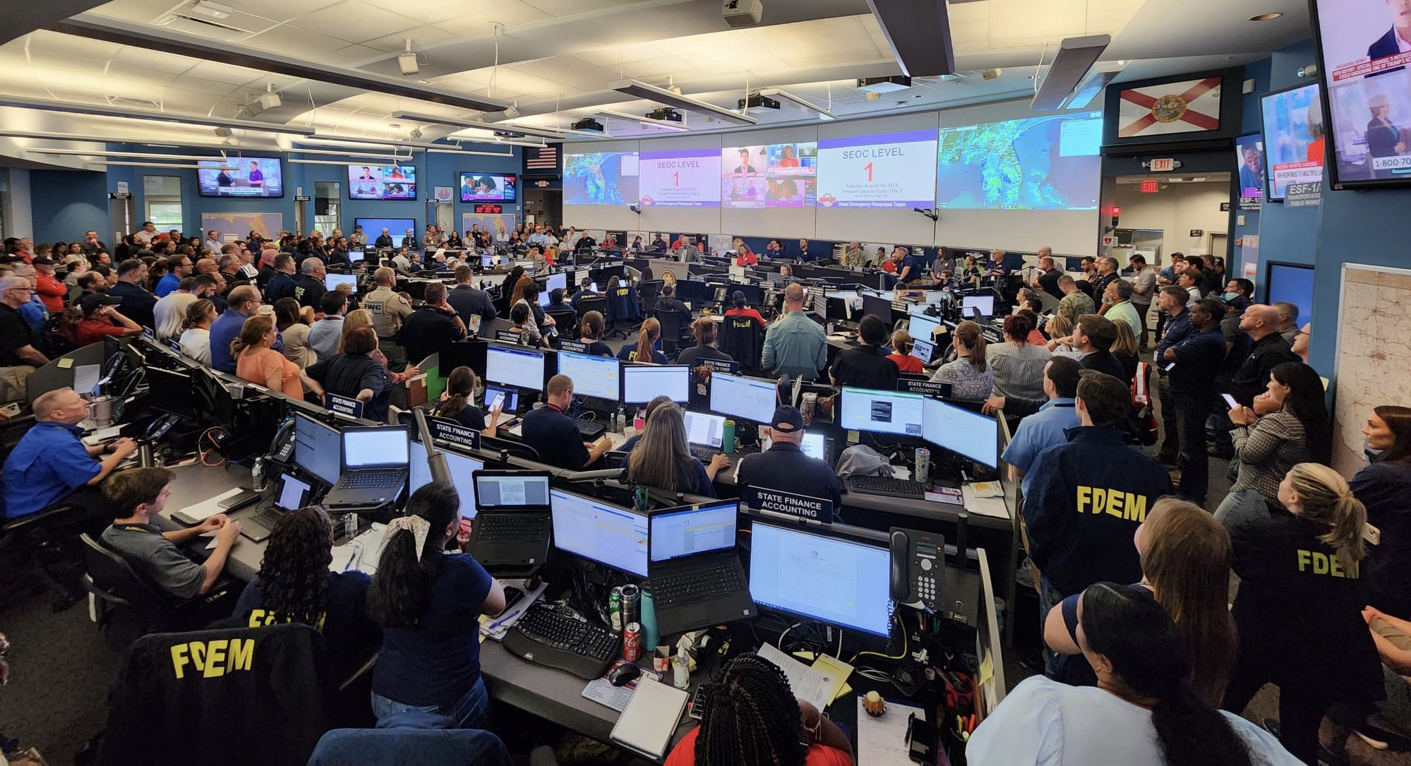
State Emergency Operations Center (SEOC) Tallahassee

Slide 6

Florida Mission Request Process
Local Emergency First
County Responsibility to Respond
County EM requests assistance from the SEOC
SEOC assigns “Mission Request” to ESF 17
ESF 17 coordinates Mission Request and provides resources to the county
Until the county’s resources are exhausted or beyond the capability/responsibility of the county
Notes:
While we mention ESF 17, I think it’s important to highlight Florida’s emergency response structure as illustrated on this slide. This slide shows the flow of requests for assistance during large-scale incidents,
In Florida, when an emergency strikes, it is a local emergency first…counties have the responsibility to respond to emergencies before state resources can come in to assist. In Florida, each county has their own local county emergency management office and that county emergency management office is responsible for developing their own emergency preparedness plans and having resources in place to respond to the incident in their county.
Now, if a county’s resources are exhausted or the situation is beyond the responsibility or capability of the local county emergency management, then that county can make a request for assistance from the State Emergency Operations Center. The SEOC forwards the resource request to the State Emergency Response Team (SERT), which is comprised of all Emergency Support Functions. In Florida, we have 18 ESFs that make up the SERT.
After the SERT receives the resource request, the SERT assigns it to the appropriate ESF for response. Lastly, the ESF reviews the resource request to determine if they can fulfill it and, if they determine they can fulfill it, then the ESF coordinates the mission and provides direct assistance—with state resources-- to the county.

Slide 7
SART Concept of Operations

Slide 8
2004 – Creation of Florida SART
Est. 2004
ESF 17 coordinates Mission Requests with SART.
SART coordinates disaster response for animals and agriculture.
SART Received Funding:
Statewide Homeland Security Grant Program, U.S. Department of Homeland Security
Response Equipment
Training
Planning
Notes:
This is an important component of our ESF17 response. Due to ESF17 being such a broad mission area to respond to, we developed the State Agricultural Response Team (SART) to SUPPORT ESF 17. To prevent duplication of efforts when dealing with animals and agriculture in emergencies, the Florida Department of Agriculture and Consumer Services -- the lead agency for ESF-17 -- teamed up with the University of Florida’s Institute of Food and Agricultural Sciences, UF’s College of Veterinary Medicine and the USDA’s Farm Service Agency to develop a new approach to disaster relief. Together they formed SART in 2004.
SART was created as a means for ESF 17 to WORK SMARTER, NOT HARDER.
The mission of SART is to coordinate disaster response for the animals and agriculture in Florida.
So, let me tell you more about SART!

Slide 9
What is SART?
SART is a “Multi-Agency Coordination (MAC) Group”
Policy guidance + Resource Prioritization = MAC Group
Consists of 25+ partner agencies (Federal, State and NGO).
Supports ESF 17 preparedness and response:
Provides resources (personnel, volunteers, equipment, etc.).
Provides technical assistance and subject matter experts.
Coordinates information and communication flow.
Prioritizes response actions.
Notes:
MAC is also referred to as POLICY GROUP. The SART MAC group provides strategic policy guidance, and resource prioritization and allocation for ESF17.
We prioritize our response actions by holding daily conference calls to coordinate needs for the counties and state.
By activating SART, ESF17 can pool together the skills and resources from each partner agency, to provide a coordinated and efficient incident response for animal and ag sectors in Florida.

Slide 10


SART Mission
Empower Floridians through training and resource coordination to enhance all-hazard disaster planning and response for animal and agricultural issues.
Notes:
This is an important component of our ESF17 response. Due to ESF17 being such a broad mission area to respond to, we developed the State Agricultural Response Team (SART) to SUPPORT ESF 17. To prevent duplication of efforts when dealing with animals and agriculture in emergencies, the Florida Department of Agriculture and Consumer Services -- the lead agency for ESF-17 -- teamed up with the University of Florida’s Institute of Food and Agricultural Sciences, UF’s College of Veterinary Medicine and the USDA’s Farm Service Agency to develop a new approach to disaster relief. Together they formed SART in 2004.
SART was created as a means for ESF 17 to WORK SMARTER, NOT HARDER.
SART mission statement

Slide 11
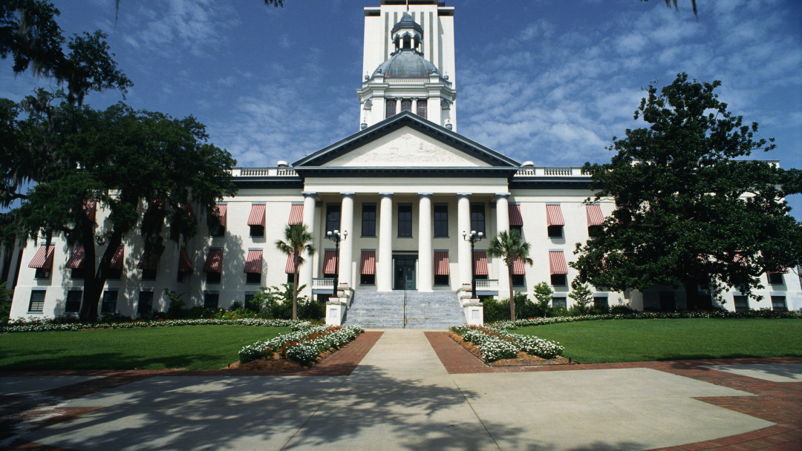

SART – 2018 Legislative Update
Statutory Authority for SART
Chapter 252, State Emergency Management Act, was amended to create statutory authority for SART (s. 252.3569, F.S.).
Effective July 1, 2018
State funding for SART
Funds provided to FDACS to coordinate the state’s response to animal and agricultural issues in Florida in the event of an emergency or disaster situation.
Notes:
Happy to announce that just this year, SART…

Slide 12
Who is SART?
Florida Department of Agriculture and Consumer Services
University of Florida/Institute of Food and Agricultural Sciences
University of Florida/College of Veterinary Medicine
University of Florida/Shelter Medicine Program
Extension Disaster Education Network
USDA/Farm Service Agency
USDA/APHIS/Animal Care
USDA/APHIS/Veterinary Services
USDA/APHIS/Wildlife Services
Florida Aquaculture Association
Florida Department of Health
Florida Farm Bureau Federation
Florida Veterinary Medical Association
Florida Animal Control Association/FAPAA
Florida Nursery, Growers and Landscape Association
Southern Plant Diagnostic Network
Florida Cattlemen's Association
Florida Association of Kennel Clubs
Florida Association of Zoos and Aquariums
Florida Fertilizer and Agrichemical Association
Florida Fish and Wildlife Conservation Commission
American Society for the Prevention of Cruelty to Animals
Florida Wildlife Rehabilitators Association
Florida Fruit and Vegetable Association
Florida State Animal Response Coalition
Florida Veterinary Technician Association
Southeast Milk, Inc.
United Dairy Farmers of Florida
Humane World for Animals (formerly HSUS)
American Society for the Prevention of Cruelty to Animals
Notes:
Who is SART? SART is made up of over 25 partner agencies. Some of our partner agencies are…

Slide 13
SART Supports Counties
Counties must address agriculture, animal and vector control incident response issues, but may not have the resources needed.
SART responds to counties’ requests for assistance through the cooperative efforts of its partner agencies.
SART “fills a gap” for ESF 17 incident response at the local and state level.

Slide 14
ESF 17/SART Response - CONOPS
SEOC
SART MAC Group
Tallahassee
(off-site)
Policy/Coordination
Federal Resources
ESF 17
State Resources
Non-governmental Resources
IMT
Incident Location
(on-site)
Tactical Resources
SART Agency Representatives (“Liaisons”)
Field Response
Notes:
Putting it all together…the ESF 17 and SART response is a large coordination effort.
REMEMBER, SART is a support team for ESF 17 that assists the counties and state to work together to coordinate animal and agricultural issues.
Hopefully this diagram can illustrate how this coordinate effort works.
In this response structure, you can see 2 things:
First: The SART MAC Group serves off-site to assist ESF 17 at the SEOC by providing policy guidance and coordinate through the daily conference calls.
Second: The SART MAC Group also serves on-site at the Incident Command Post or Incident Location to provide tactical resources for the ICP.
This MAC structure allows SART and ESF 17 to make cooperative multi-agency decisions in order to support an efficient incident response.

Slide 15
Building Capacity 2004-Present
Notes:
Planning Committee asked me to provide a HEAVY focus on how we built our capacity.
I will go through our resource building here, then give a brief overview of Hurricane Ian response and where we applied our resources.

Slide 16
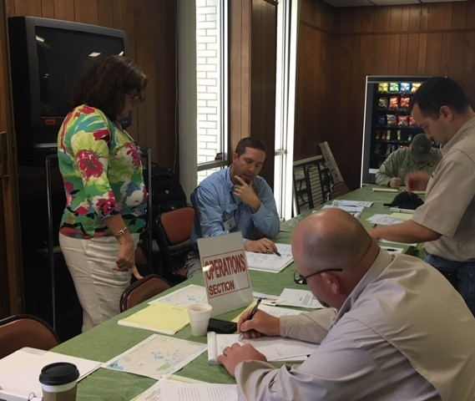
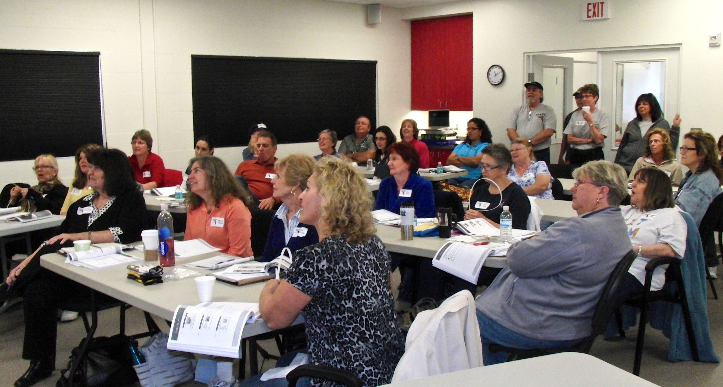
Incident Command System (ICS) Training
SART sponsors and pays for required ICS training for our ESF 17 responders.
Pre-assigned Incident Management Team for ESF 17.
Trained and experienced.
Notes:
The Incident Command System (ICS) is a standardized approach to the command, control, and coordination of emergency response providing a common hierarchy within which responders from multiple agencies can be effective.

Slide 17
Type III, Incident Management Team (IMT)
Respond to WebEOC mission requests.
Set up Incident Command Post, Logistical Staging Area, and Donation Staging Area.
Florida SART partners as “Agency Representatives” to the Liaison Officer and Operations:
IMT Operations Section:
Animal Health Assessment Group
Livestock Support Group
Veterinary Support & Sheltering Group
Donation & Distribution Group
Notes:
Responded to 103 mission requests in WebEOC – the state’s official system for resource requests and tracking between county, state and federal agencies.
The ESF17 IMT focused incident objectives on small and large animal search and rescue, animal health assessments, animal and agricultural operational status assessments, establishment of distribution points for agricultural supplies, receiving and distributing animal feed and water, supporting pet-friendly shelters and animal shelters, operating mobile animal clinics, and providing veterinary emergency teams for 81 USAR search and rescue canines.

Slide 18
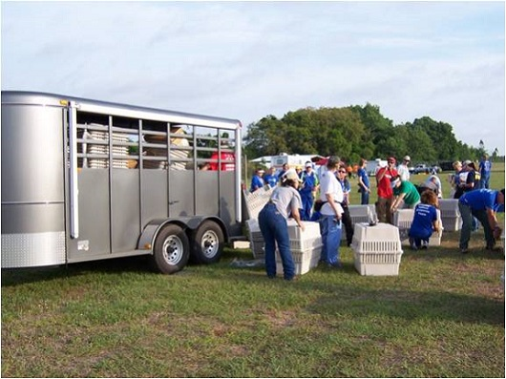
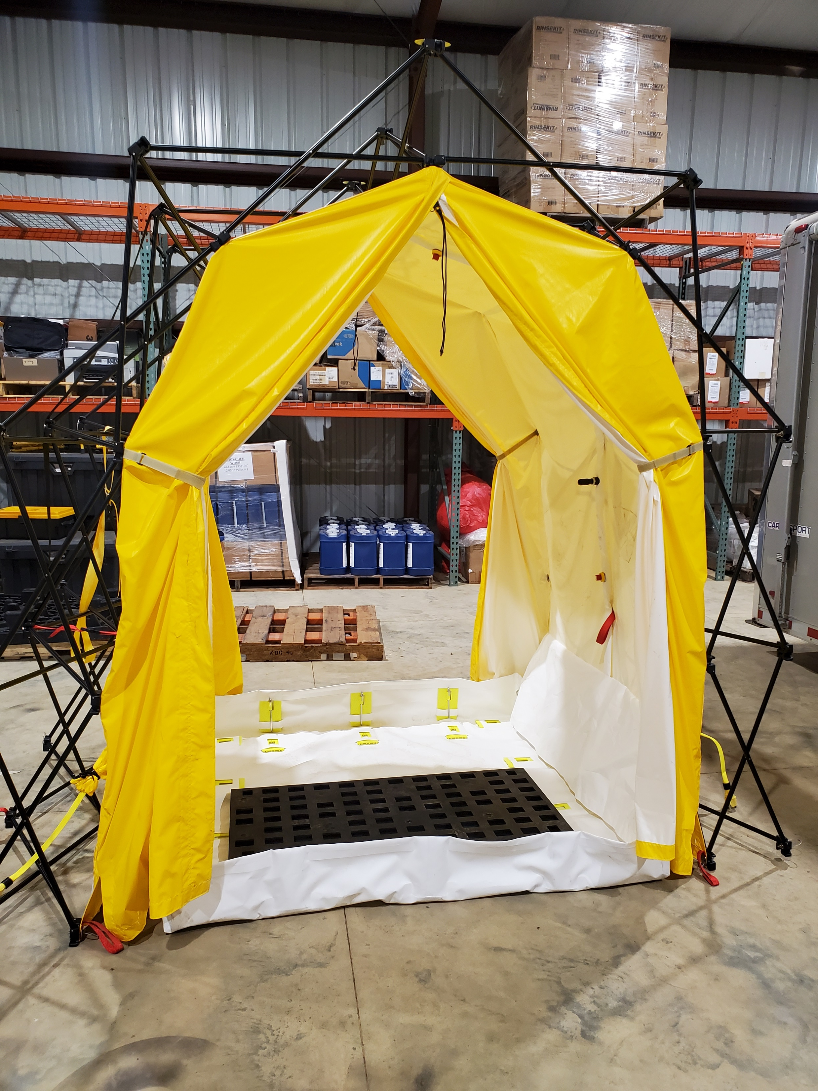
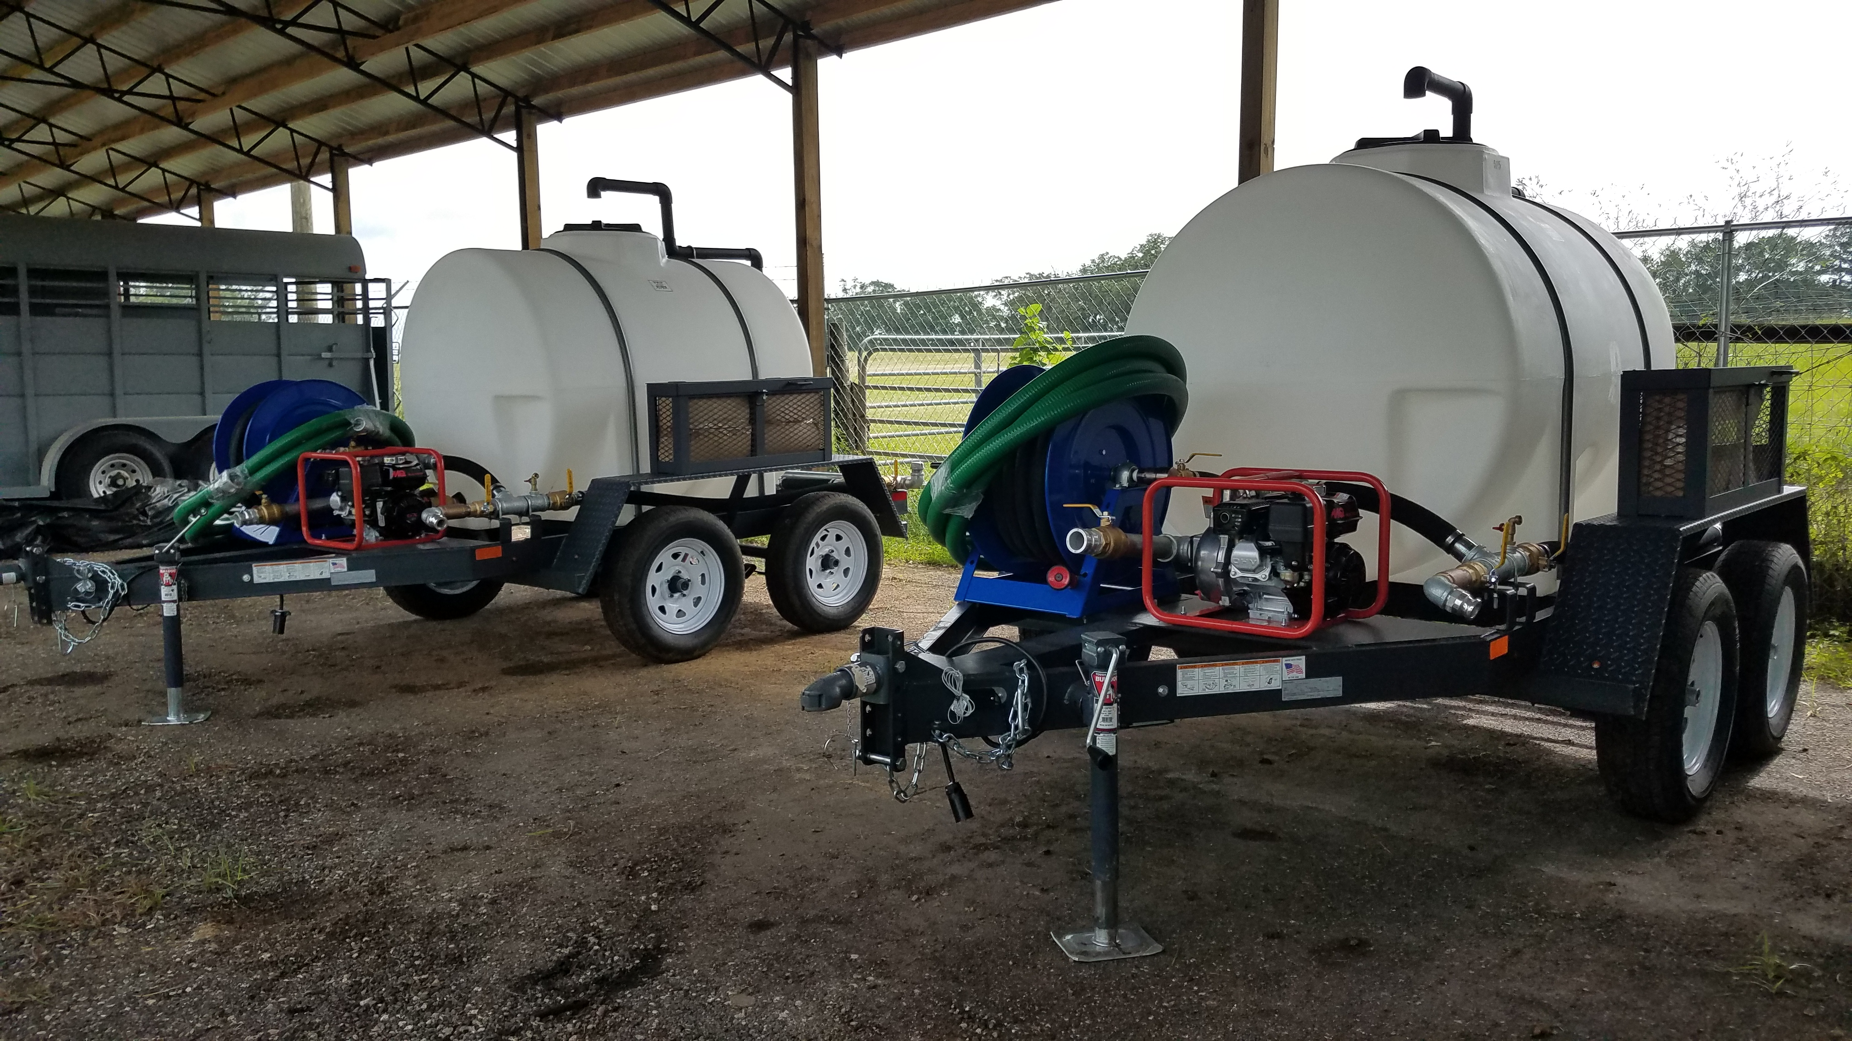
Animal Response Equipment
Animal Sheltering Equipment Mobile Animal Response Equipment (MARE)
Livestock Trailers
Livestock Panels
Biosecurity/Decon Equipment
FAD & PPE Go-Trailers
525-Gallon Water Haulers
Notes:
14 MARE Units are Mobile Animal Response Equipment units that SART purchased and staged across the State of Florida. MARE Unit are 16-foot livestock trailers that carry enough supplies -- from crates to bowls and food -- to set up a temporary shelter for up to 150 companion animals. Other MARE equipment includes sleeping trailers and portable showers for the personnel, livestock carriers, and portable water haulers. We have MARE units stationed throughout the state where they are available to local authorities as they’re needed. Designed to be deployable to any impacted region.

Slide 19
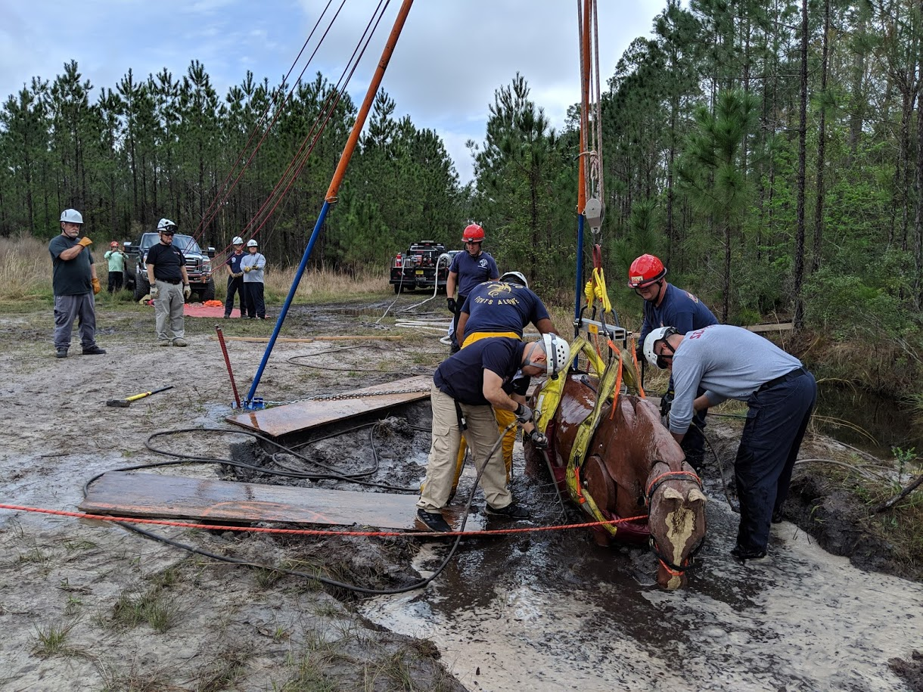
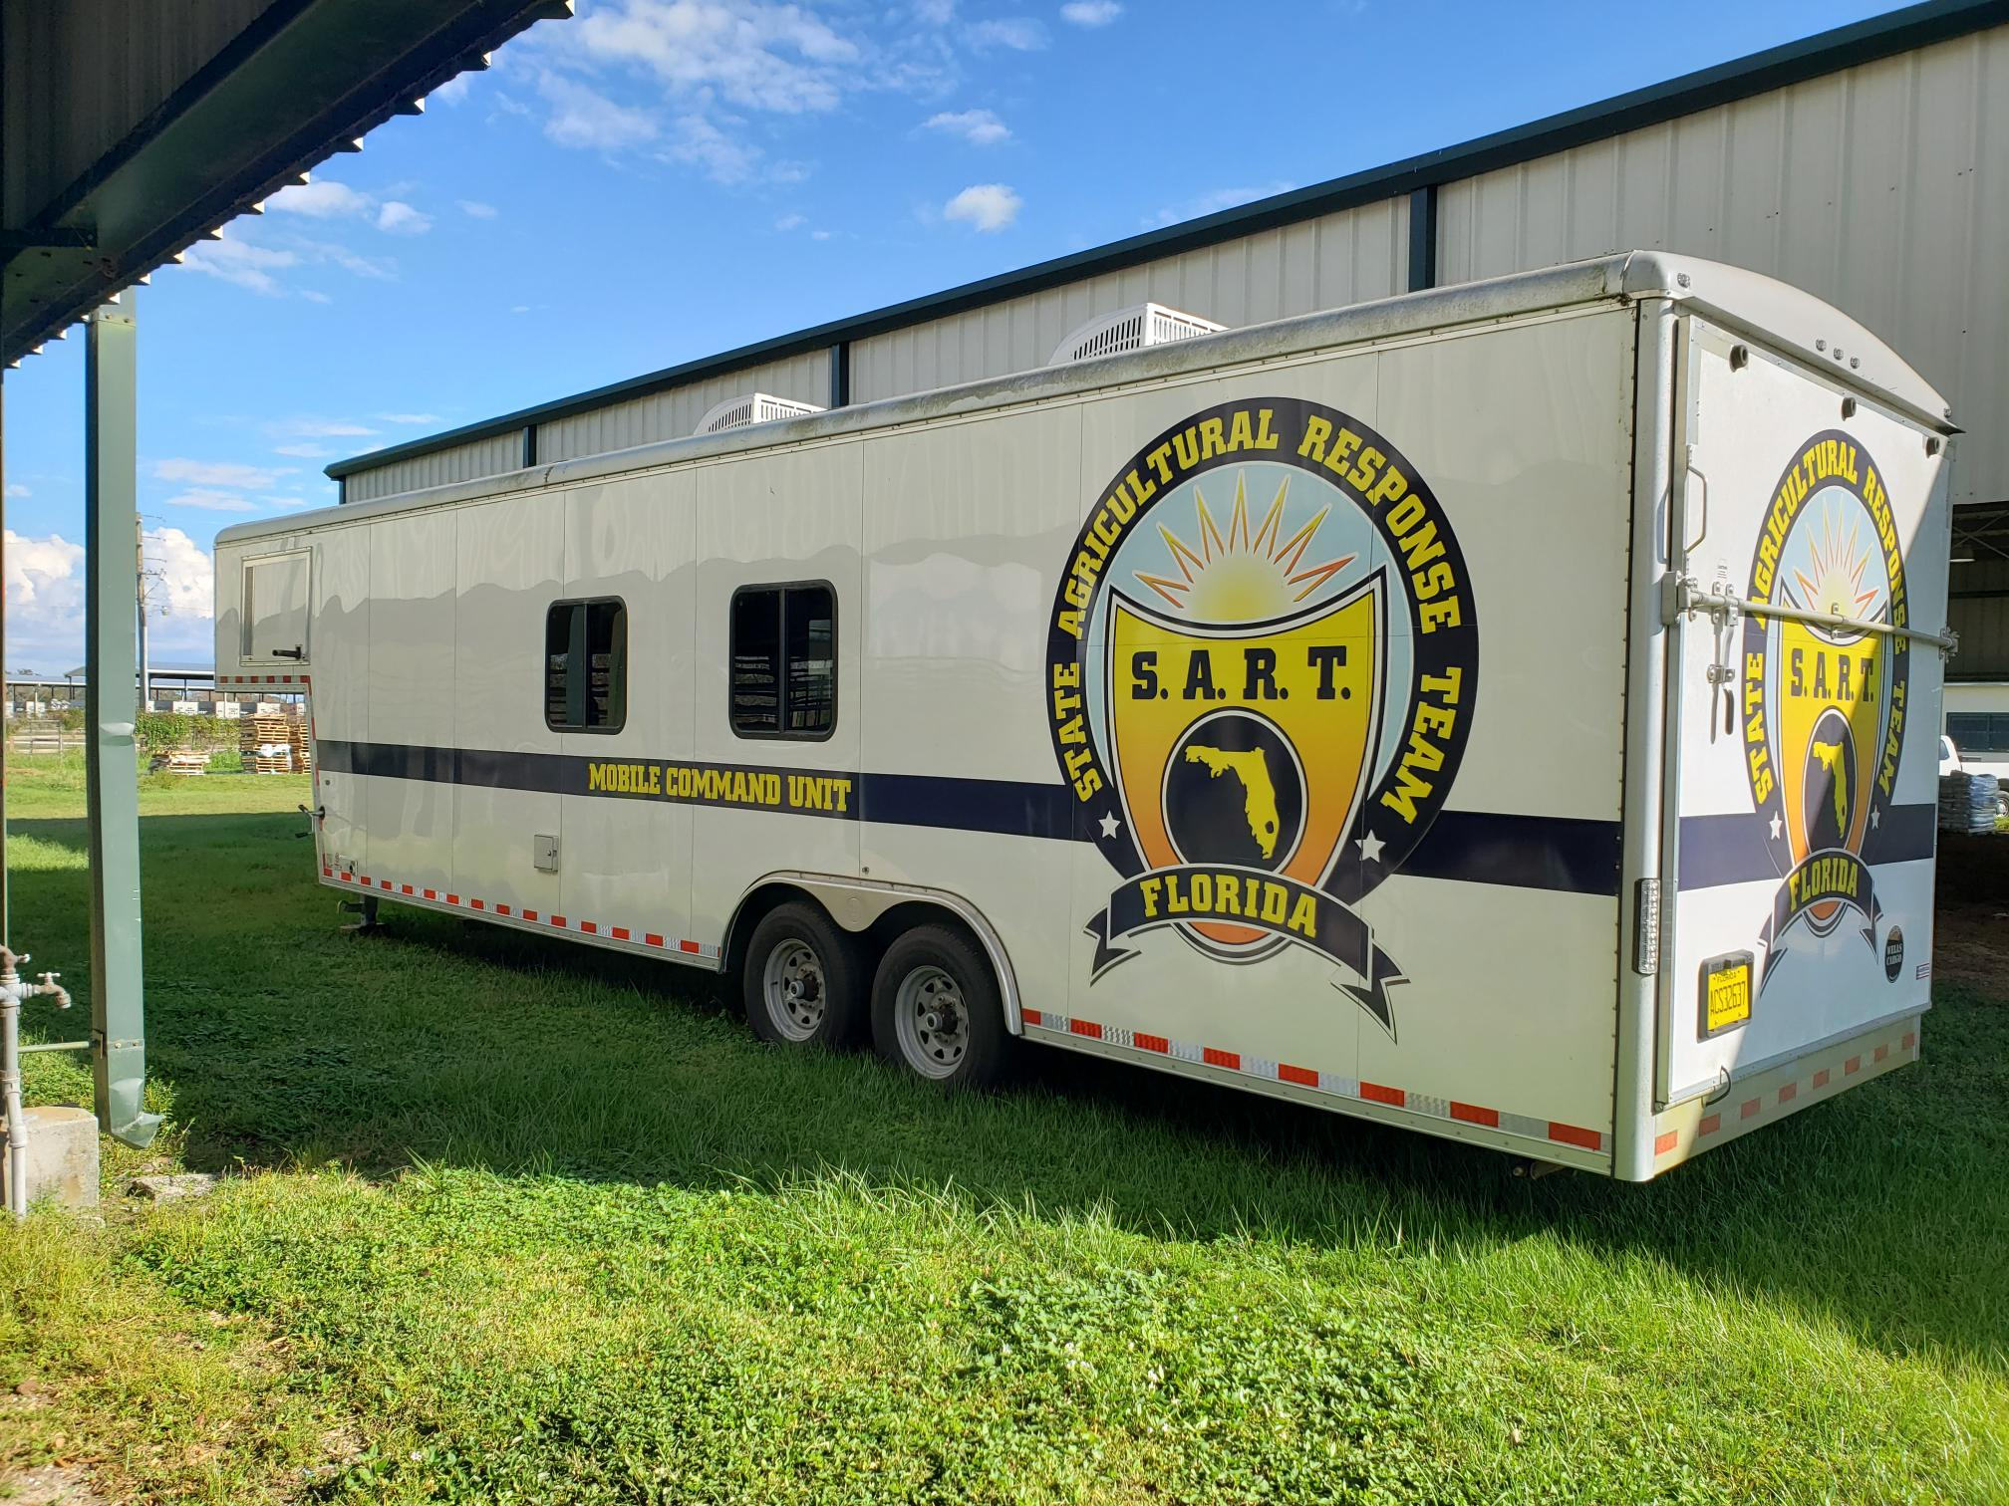
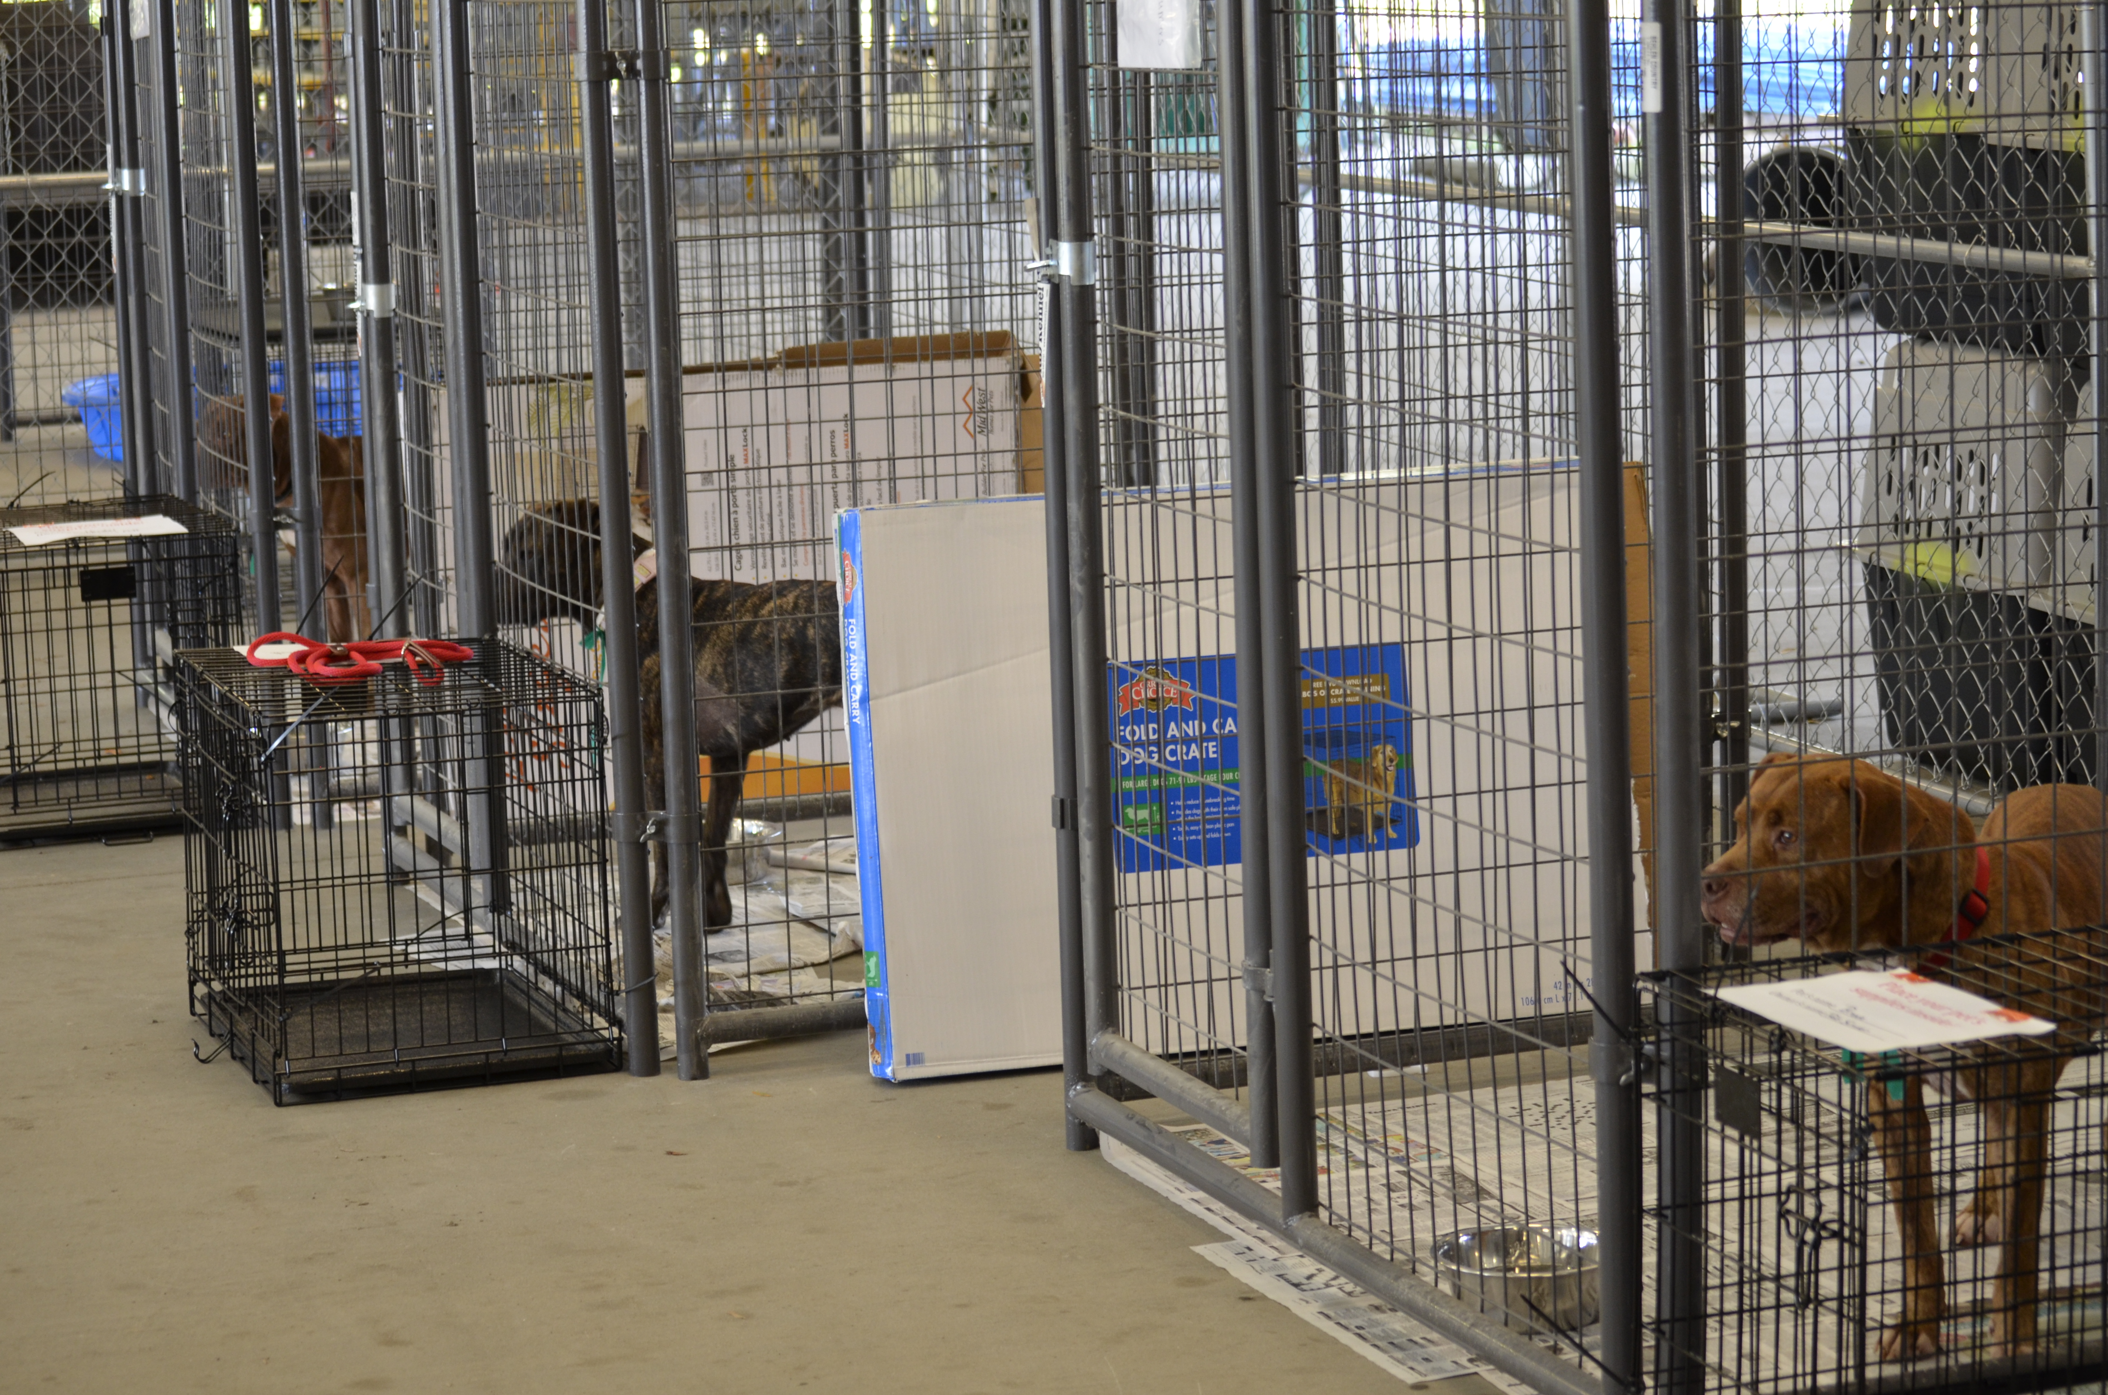
Animal Response Equipment
Command Trailer
Utility Trailers
Bunkhouse Trailers
Magnum Kennels
Animal Technical Rescue Equipment

Slide 20
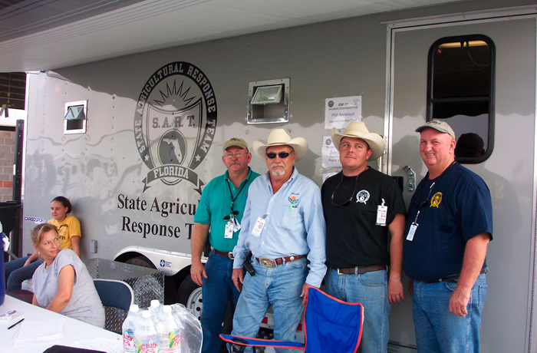
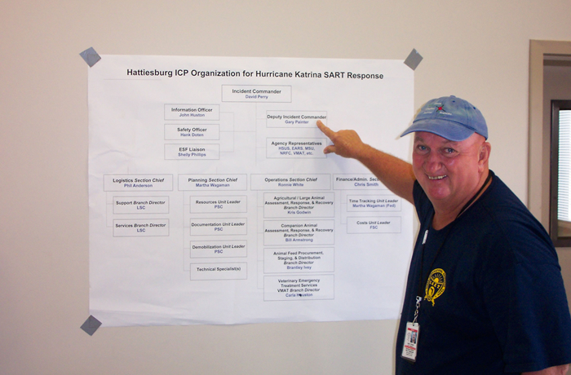
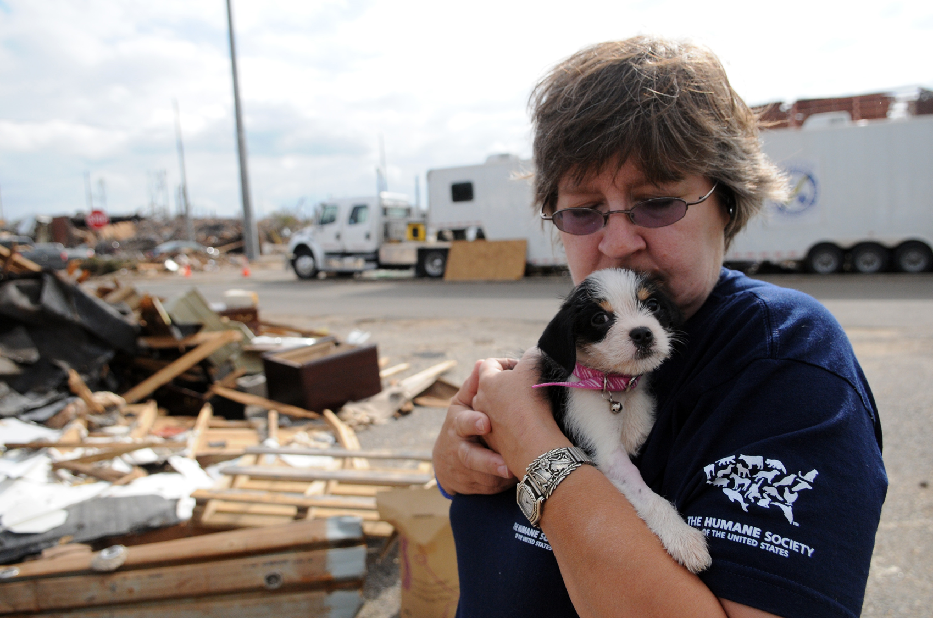
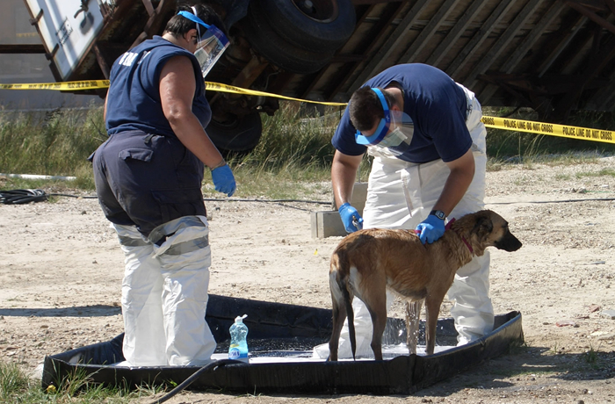
2005 Hurricanes & 2006 PETS Act
2005 Hurricanes Dennis, Katrina, Wilma, Rita, and Ike
2005 Hurricane Katrina – ESF 17 & SART Emergency Management Assistance Compact (EMAC) to Mississippi
2006 Pets Evacuation and Transportation Standards (PETS) Act
Notes:
Pictured above is our SART partner from the Human Society of the United States when we deployed for Hurricane Katrina.

Slide 21
2020 Legislation FL Governor Signs CS/HB 705: Emergency Sheltering of Persons with Pets
252.3568 Emergency sheltering of persons with pets.—
(1) In accordance with s. 252.35, the division shall address strategies for the evacuation of persons with pets in the shelter component of the state comprehensive emergency management plan and shall include the requirement for similar strategies in its standards and requirements for local comprehensive emergency management plans. The Department of Agriculture and Consumer Services and the Department of Education shall assist the division in determining strategies regarding this activity.
(2) If a county maintains designated shelters, it must also designate a shelter that can accommodate persons with pets. The shelter must be in compliance with applicable FEMA Disaster Assistance Policies and Procedures and with safety procedures regarding the sheltering of pets established in the shelter component of both local and state comprehensive emergency management plans.
Notes:
Effective July 1, 2020, counties within the State of Florida must designate a pet-friendly shelter that can accommodate persons with pets.
New language is underlined.
This statutory authority is important to keep in mind for your planning.

Slide 22
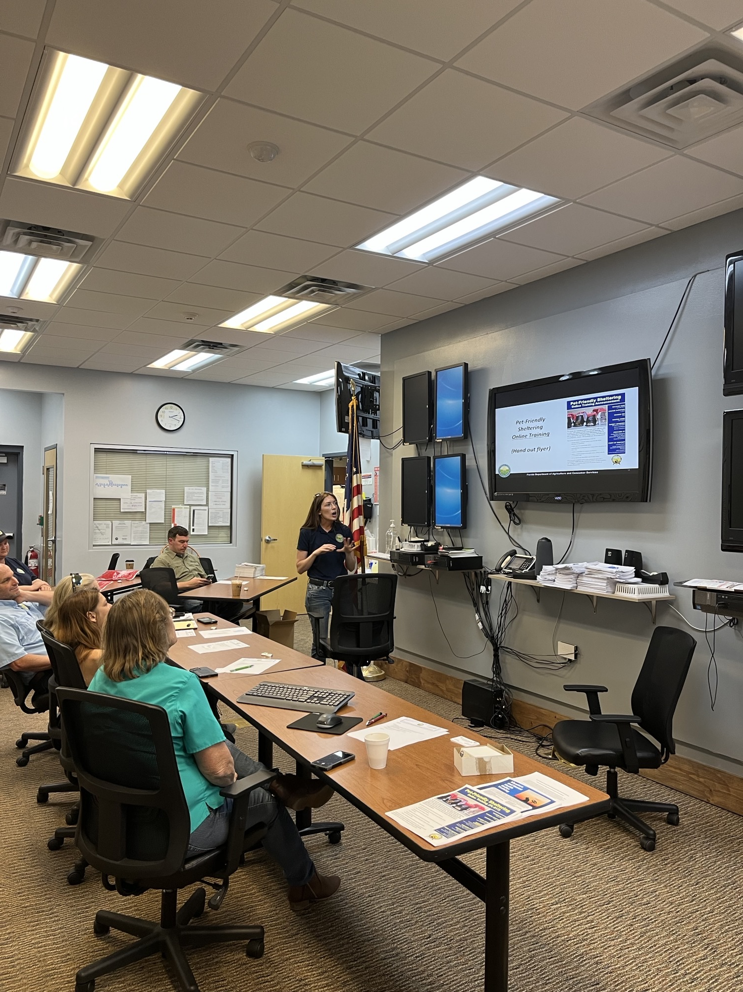
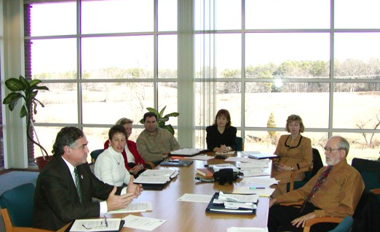
ESF 17 Annual County Meetings
Meet with all 67 Florida counties.
Notes:
Make personal contact with ESF 17 county emergency management and stakeholders.
Support county ESF 17 personnel with information, coordination, training, and resources.
Discuss state ESF 17 activities.
Solicit information and feedback.

Slide 23
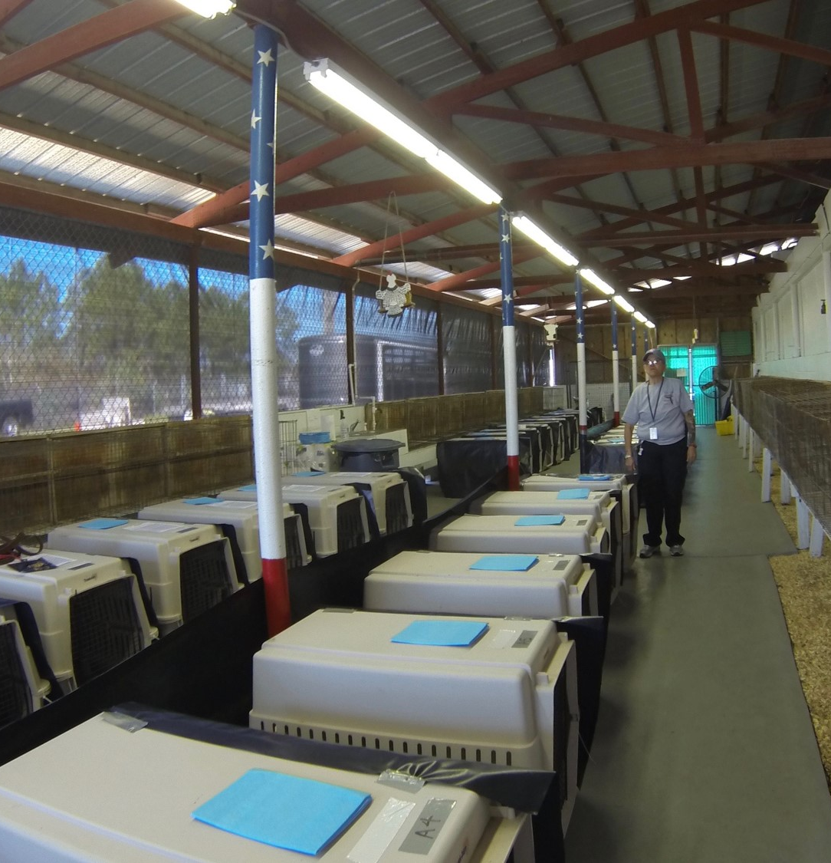

Developed Training: Small Animal Emergency Sheltering
Teaches participants how to build and operate a temporary emergency small animal shelter in response to natural disasters or large animal cruelty cases.
Awareness and Operations Levels.
State-certified by Florida Division of Emergency Management.
Tuition is sponsored by Florida SART.
>1,000 trained and enlisted volunteers.
Notes:
This is another SART-sponsored training.

Slide 24



Slide 25
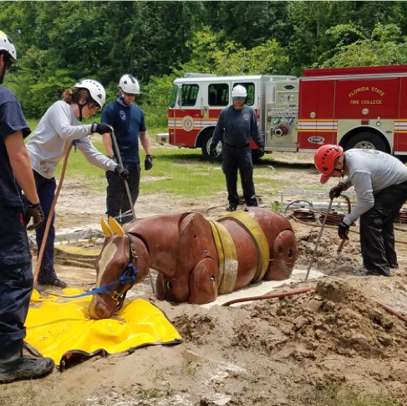

Developed Training: Animal Technical Rescue
Teaches animal technical rescue team members the proper techniques to extricate animals from hazardous emergency situations.
Awareness and Operations Levels.
State-certified by Florida Division of Emergency Management.
Meets National Fire Protection Association (NFPA) standards.
Tuition is sponsored by Florida SART.
Notes:
Our SART partner for animal technical rescue is the UF Veterinary Emergency Treatment Service based at the College of Veterinary Medicine. Through this partnership, the Animal Technical Rescue operations level training course was first developed in 2011. This training is state-certified by the Florida Division of Emergency Management, recognized by the Florida State Fire College, and meets National Fire Protection Associations standards. Although this class is available to any interested person, it is primarily targeted toward law enforcement, fire/rescue, animal control officers, and veterinary professionals. Animal Technical Rescue teams are not medical teams, rather they are trained in proper techniques to safely extricate animals from hazardous emergency situations. Trainees learn low angle rescue techniques including assists with webbing and packaging techniques for large animal patients, high angle rescue techniques including application of slings and rope rescue techniques for large animal loads, and important principles to maintain human safety and animal welfare.

Slide 26
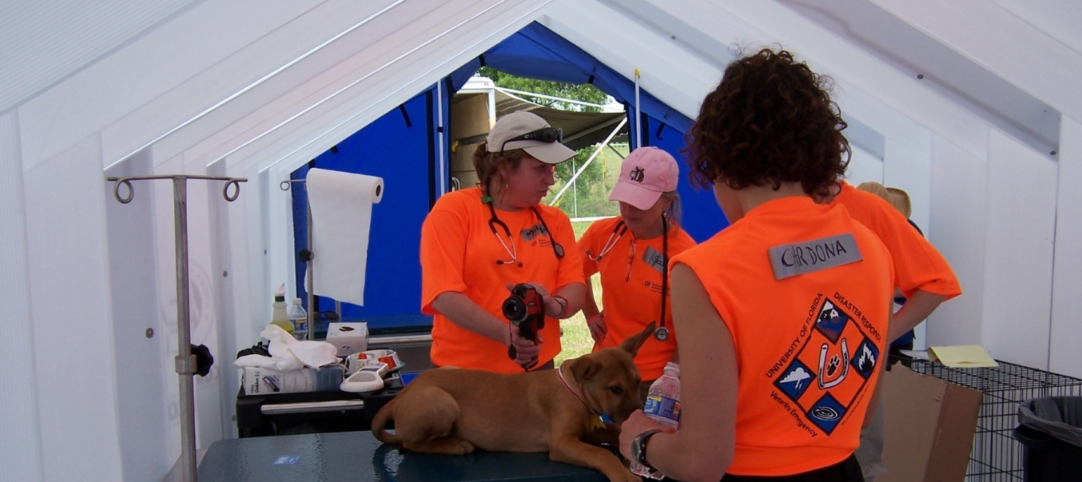
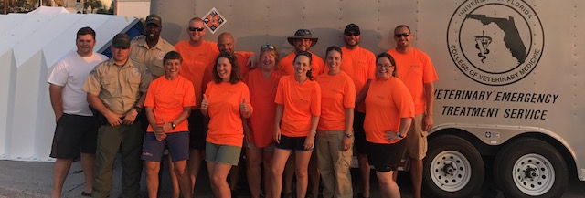

Veterinary Emergency Treatment Services (VETS) Team
University of Florida, College of Veterinary Medicine.
Over 50 veterinarians and staff.
Only veterinary response team available in Florida.

Slide 27

Established to enlist private veterinarians and veterinary technicians for response actions.
Provide assistance to their communities and the state during a disaster.
Over 200 individuals have signed up.
Sign up at www.FLSART.org

Slide 28



Slide 29
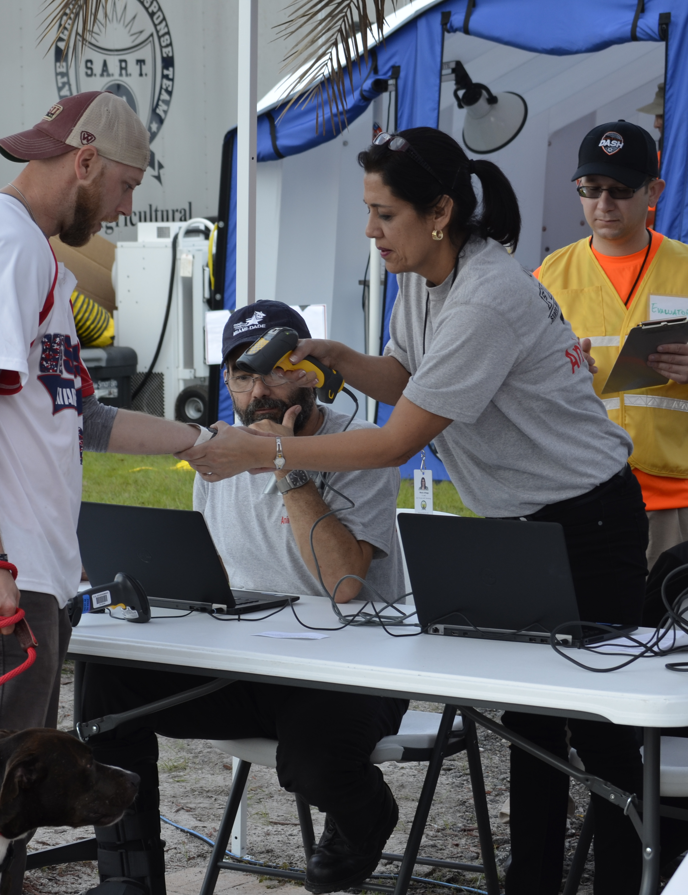
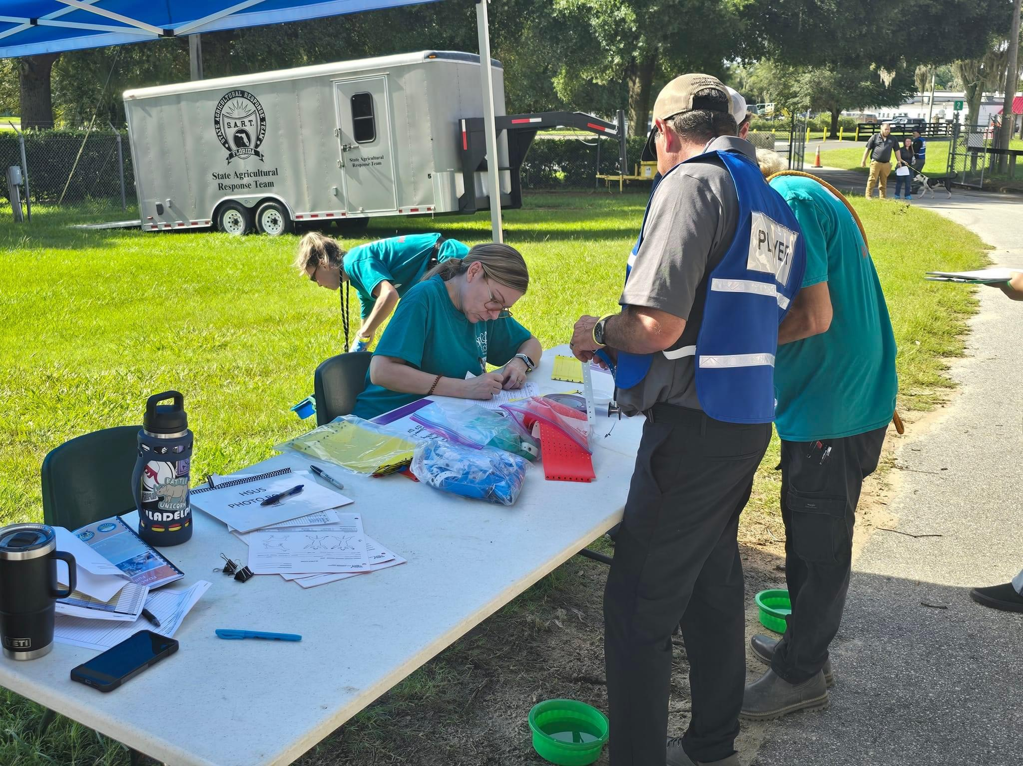
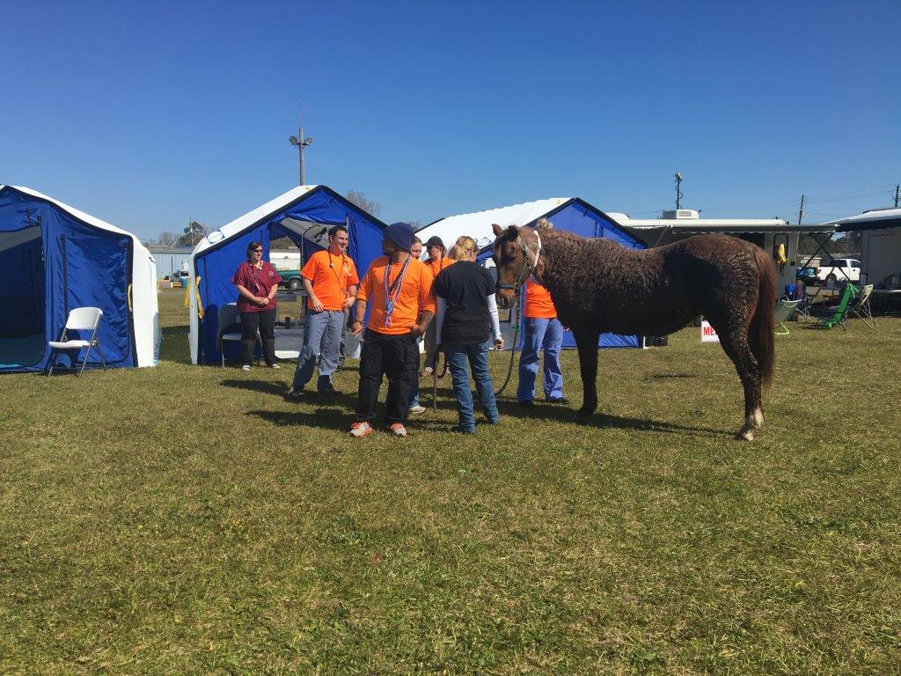
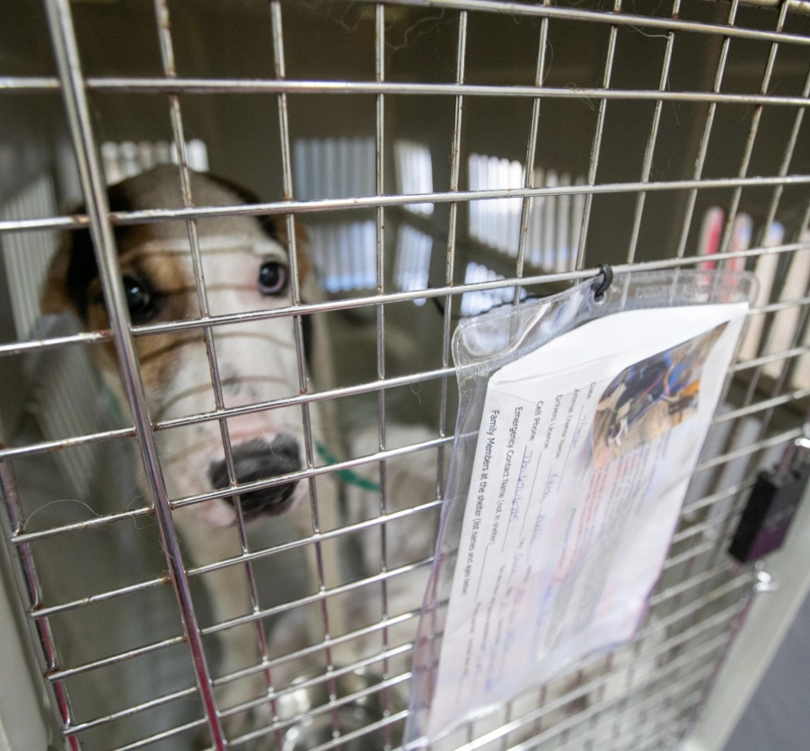
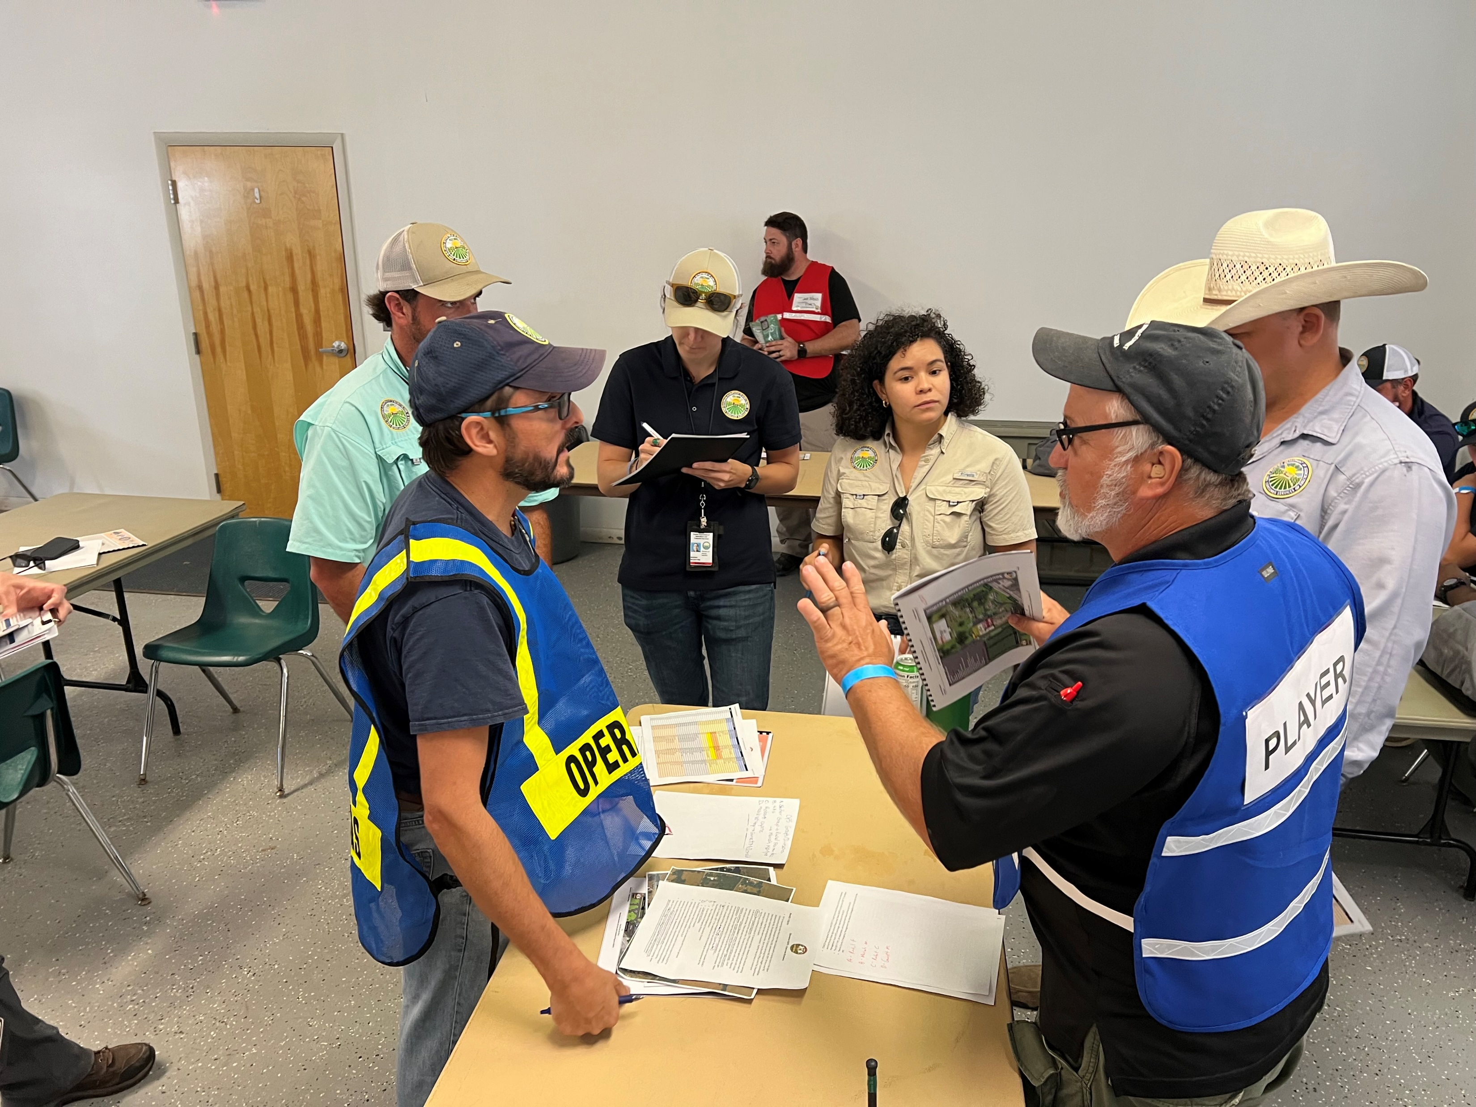
Full-Scale Exercises with County EM
Practice Unified Command IMT with county and state
Threat impacting animals AND agriculture
County and state each provide resources
Sponsored by SART
Next exercise in 2026
Notes:
Disaster Preparedness Workshops and Full-Scale Exercises.
2016 – Bay County
2017 – Hillsborough County
Participants from county EM office, local bus transport company, SART partners (FDOH, UF, SARC, USDA), and FEMA

Slide 30
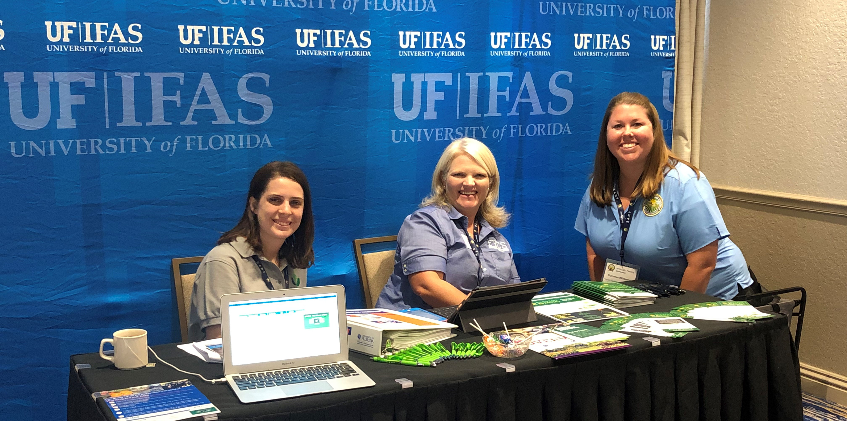
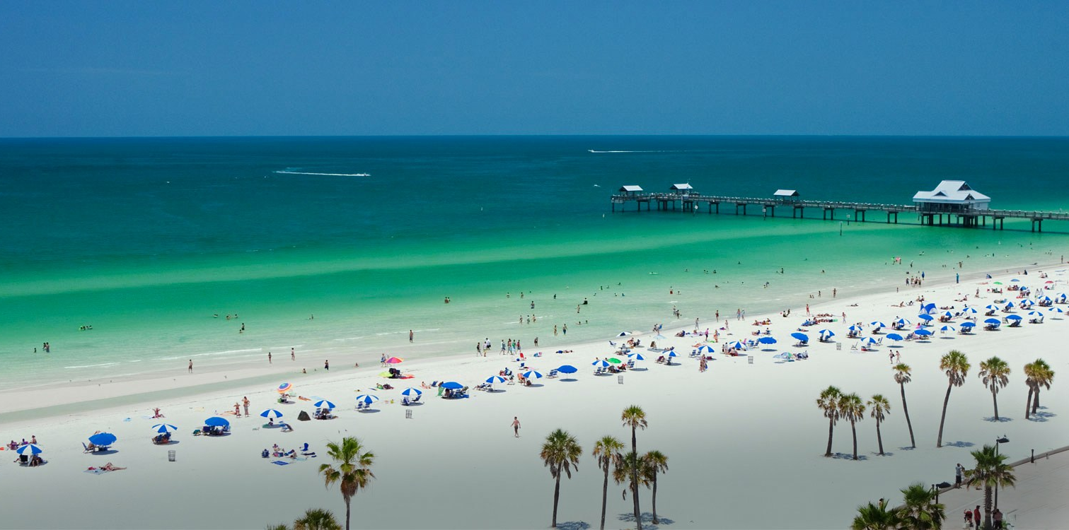
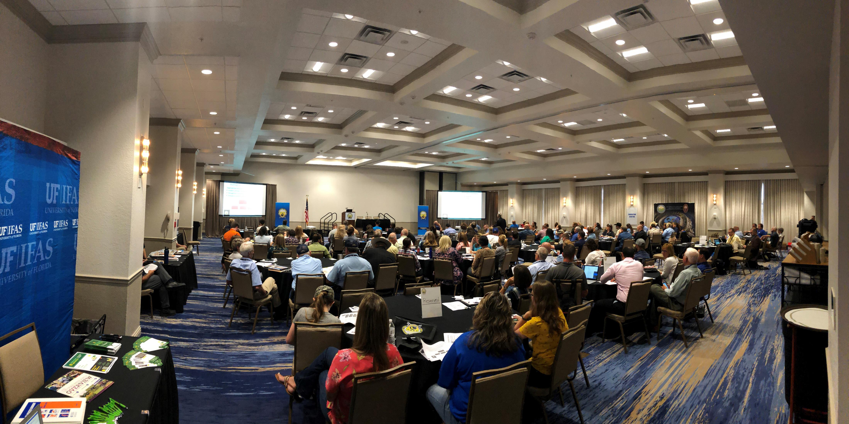
SART Planning Conferences
SART sponsors a biennial statewide planning conference for all 67 Florida counties and SART partner agencies.
Notes:
Conference provides Florida counties with resources needed to better prepare for and respond animal and ag issues.
Gap at county level.
This is one of the ways SART works with the counties to improve animal and ag preparedness, and help fill that gap for incident response at the county level.

Slide 31

SART Website
Is a critical information and communication bridge between SART members and partner agencies.
Over 45,000 visits a month.
Register for a SART member account!
www.FLSART.org
Notes:
As a means to communicate all these resources, we developed a SART website.

Slide 32

The Sentinel
Monthly newsletter for SART of stories from around the state, trainings and meeting events.
Distributed to SART partner agencies and over 1,200 members signed up to receive through the SART website.
Is a critical information source.
www.FLSART.org
Notes:
Invite counties to share their ESF 17 preparedness and response efforts with us. We would love to feature an article about it in The SART Sentinel!

Slide 33

Thank you!
LeiAnna Moorhead
(850) 410-0920
LeiAnna.Moorhead@FDACS.gov
Notes:
As you can see, the ESF 17 mission area is broad, but it involves many important components ranging from animals to agriculture, food safety and security, vector control, animal disease prevention, and so on…
SART gives our Florida counties and our Department the resources we need to protect Florida’s animal and ag sectors during an emergency. We really could not do it without our SART partners.

